Slide 1
Query Processing
ownerNoclient

Slide 2
Introduction
RDBMS have some inherent weaknesses
  Flatness
    Hence some dbms (postres, oracle) have OO components
    They are Object Relational
  Expensive Queries
    Queries are expensive to execute
    Have to go through an eraborate process to process and make cheaper
    SQL is just declarative. Writer does not cater for complexity
Hence
  process called QUERY PROCESSING

Slide 3
Introduction
DBMS, not user, in control of performance
From simple to complex approaches
  heuristic rules that order operations in a query;
  comparing strategies based on relative costs
  Make intelligent deductions
  Process in batches and share output
Disk access tends to be dominant cost in QP

Slide 4
Query Processing
Effectively retrieve data from databases in response to a query
Aims of QP:
  transform SQL query into correct and efficient execution strategy expressed in low-level language (implementing Relational Algebra);
  execute strategy to retrieve required data.

Slide 5
Query Optimization
choosing an efficient execution strategy
There are many equivalent transformations of same high-level query, QO choose one that minimizes resource usage.
Generally, reduce total execution time of query.
May also reduce response time of query.
Normally we look for near optimum solution

Slide 6
Example
Find all Managers who work at a London branch.
  SELECT *
  FROM Staff s, Branch b
  WHERE s.branchNo = b.branchNo AND
  (s.position = ‘Manager’ AND b.city = ‘London’);
What are the RA equivalents? U can use Join and Conjunction for simplicity

Slide 7
Different Strategies
Three equivalent RA queries are:
(1) σ(position='Manager') ∧ (city='London') ∧
  (Staff.branchNo=Branch.branchNo) (Staff X Branch)
(2) σ(position='Manager') ∧ (city='London')(
  Staff _{Staff.branchNo=Branch.branchNo} Branch)
(3) (σ_{position='Manager'}(Staff)) _{Staff.branchNo=Branch.branchNo}
  (σ_{city='London'} (Branch))
  Do You think they take the same memory to execute?

Slide 8
Example …
Assume:
  1000 tuples in Staff; 50 tuples in Branch;
  50 Managers; 5 London branches;
  results of any intermediate operations stored on disk;
  cost of the final write is ignored;
  tuples are accessed one at a time.

Slide 9
Example : cost estimation
Cost (in disk accesses) are:
(1) (1000 + 50) + 2*(1000 * 50) = 101 050
(2) 2*1000 + (1000 + 50) = 3 050
(3) 1000 + 2*50 + 5 + (50 + 5) = 1 160
Note
  Cartesian product and join operations much more expensive than selection and third option reduces size of relations being joined together.
© Pearson Education Limited 1995, 2005

Slide 10
Phases of Query Processing
QP has four main phases:
  decomposition
    parsing
    validation
  optimization;
  code generation;
  execution.

Slide 11
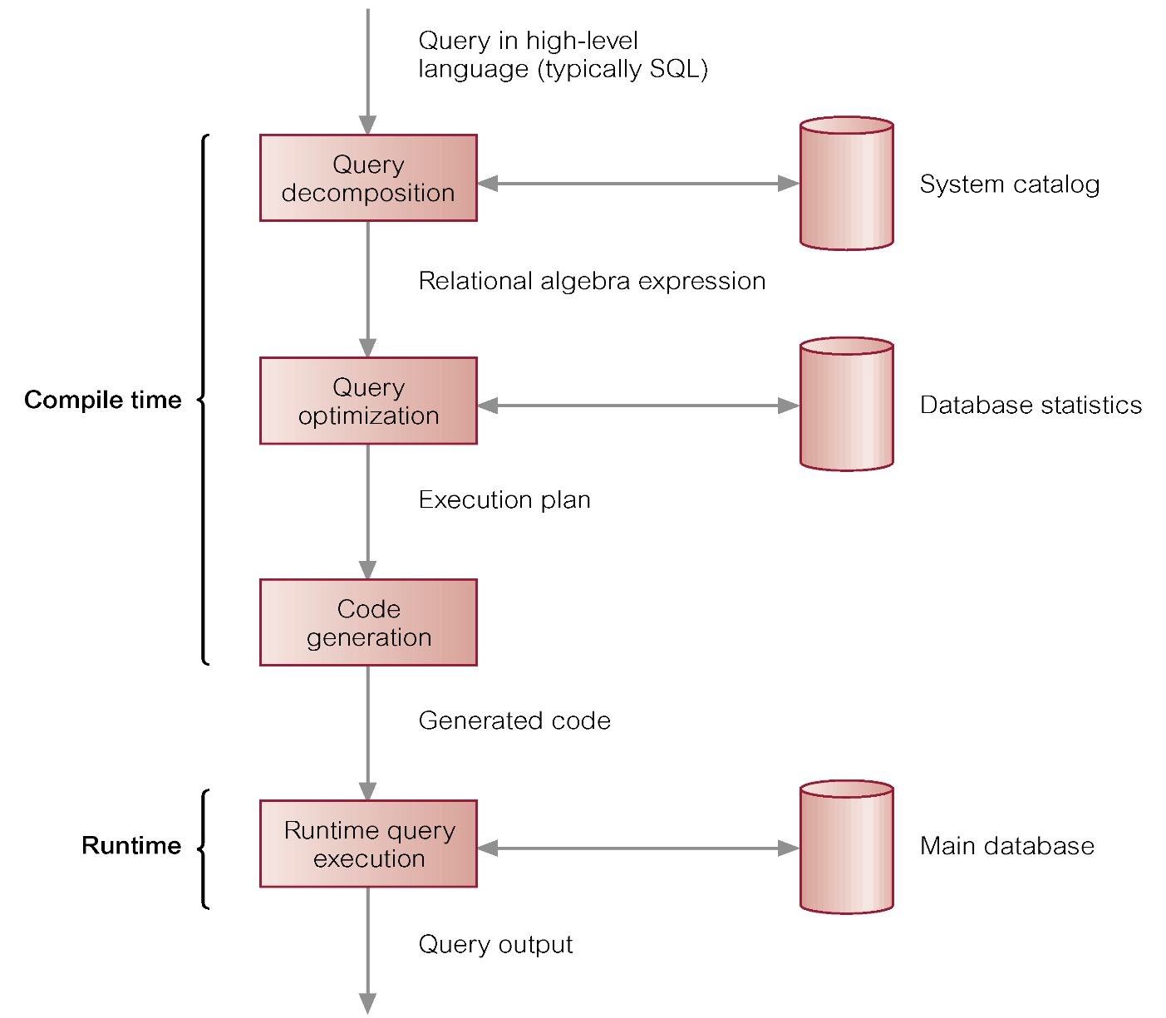
Phases of Query Processing

Slide 12
Dynamic versus Static Optimization
Two times when first three phases of QP can be carried out:
  dynamically every time query is run;
  statically when query is first submitted.
Advantages of dynamic QO arise from fact that information is up to date.
Disadvantages are that performance of query is affected, time may limit finding optimum strategy.

Slide 13
Dynamic versus Static Optimization
Advantages of static QO are removal of runtime overhead, and more time to find optimum strategy.
Disadvantages arise from fact that chosen execution strategy may no longer be optimal when query is run.
Could use a hybrid approach to overcome this.

Slide 14
Query Decomposition
Aims are to transform high-level query into RA query and check that query is syntactically and semantically correct.
Typical stages are:
  analysis,
  normalization,
  semantic analysis,
  simplification,
  query restructuring.

Slide 15
Analysis
Analyze query lexically and syntactically using compiler techniques.
Verify relations and attributes exist.
Verify operations are appropriate for object type.

Slide 16
Analysis - Example
  SELECT staff_no
  FROM Staff
  WHERE position > 10;
This query would be rejected on two grounds:
  staff_no is not defined for Staff relation (should be staffNo).
  Comparison ‘>10’ is incompatible with type position, which is variable character string.

Slide 17
Analysis
Finally, query transformed into some internal representation more suitable for processing.
Some kind of query tree is typically chosen, constructed as follows:
  Leaf node created for each base relation.
  Non-leaf node created for each intermediate relation produced by RA operation.
  Root of tree represents query result.
  Sequence is directed from leaves to root.

Slide 18
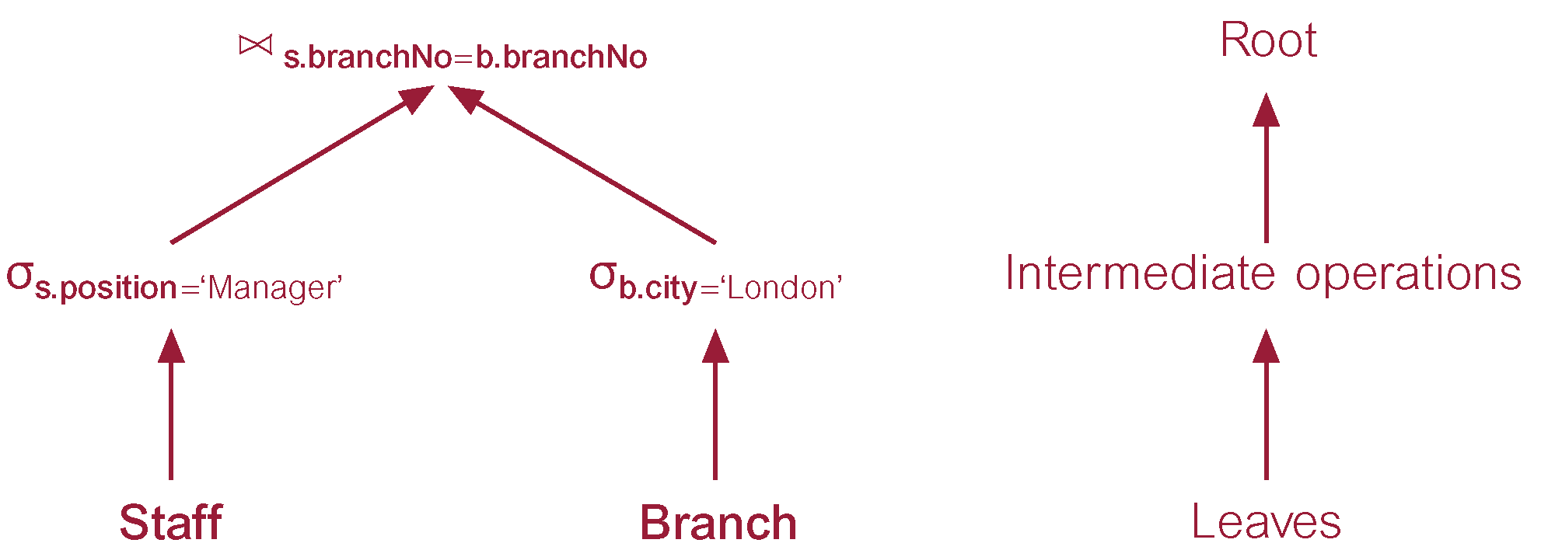
Tree

Slide 19
Normalization
Converts query into a normalized form for easier manipulation.
Predicate can be converted into one of two forms:
Conjunctive normal form:
  (position = 'Manager' ∨ salary > 20000) ∧ (branchNo = 'B003')
Disjunctive normal form:
  (position = 'Manager' ∧ branchNo = 'B003' ) ∨
  (salary > 20000 ∧ branchNo = 'B003')

Slide 20
Semantic Analysis
Rejects normalized queries that are incorrectly formulated or contradictory.
Query is incorrectly formulated if components do not contribute to generation of result.
Query is contradictory if its predicate cannot be satisfied by any tuple.
Algorithms to determine correctness exist only for queries that do not contain disjunction and negation.

Slide 21
Simplification
  Detects redundant qualifications,
  eliminates common sub-expressions,
Typically, access restrictions, view definitions, and integrity constraints are considered.

Slide 22
Transformation Rules for RA Operations
Conjunctive Selection operations can cascade into individual Selection operations (and vice versa).
  σ_{p∧q∧r}(R) = σ_{p}(σ_{q}(σ_{r}(R)))
Sometimes referred to as cascade of Selection.
  σ_{branchNo='B003' ∧ salary>15000}(Staff) = σ_{branchNo='B003'}(σ_{salary>15000}(Staff))

Slide 23
Transformation Rules for RA Operations
Commutativity of Selection.
  σ_{p}(σ_{q}(R)) = σ_{q}(σ_{p}(R))
For example:
  σ_{branchNo='B003'}(σ_{salary>15000}(Staff)) = σ_{salary>15000}(σ_{branchNo='B003'}(Staff))

Slide 24
Transformation Rules for RA Operations
In a sequence of Projection operations, only the last in the sequence is required.
  Π_{L}Π_{M} … Π_{N}(R) = Π_{L} (R)
For example:
  Π_{lName}Π_{branchNo, lName}(Staff) = Π_{lName} (Staff)

Slide 25
Transformation Rules for RA Operations
Commutativity of Selection and Projection.
If predicate p involves only attributes in projection list, Selection and Projection operations commute:
  Π_{Ai, …, Am}(σ_{p}(R)) = σ_{p}(Π_{Ai, …, Am}(R)) where p∈ {A₁, A₂, …, A_{m}}
For example:
  Π_{fName, lName}(σ_{lName='Beech'}(Staff)) = σ_{lName='Beech'}(Π_{fName,lName}(Staff))

Slide 26
Transformation Rules for RA Operations
Commutativity of Theta join (and Cartesian product).
  R _{p} S = S _{p} R
  R X S = S X R
Rule also applies to Equijoin and Natural join. For example:
  Staff _{staff.branchNo=branch.branchNo} Branch =
  Branch _{staff.branchNo=branch.branchNo} Staff

Slide 27
Transformation Rules for RA Operations
Commutativity of Selection and Theta join (or Cartesian product).
If selection predicate involves only attributes of one of join relations, Selection and Join (or Cartesian product) operations commute:
  σ_{p}(R _{r} S) = (σ_{p}(R)) _{r} S
  σ_{p}(R X S) = (σ_{p}(R)) X S
  where p∈ {A₁, A₂, …, A_{n}}

Slide 28
Transformation Rules for RA Operations
If selection predicate is conjunctive predicate having form (p ∧ q), where p only involves attributes of R, and q only attributes of S, Selection and Theta join operations commute as:
  σ_{p ∧ q}(R _{r} S) = (σ_{p}(R)) _{r} (σ_{q}(S))
  σ_{p ∧ q}(R X S) = (σ_{p}(R)) X (σ_{q}(S))
© Pearson Education Limited 1995, 2005

Slide 29
Transformation Rules for RA Operations
For example:
σposition='Manager' ∧ city='London'(Staff _{Staff.branchNo=Branch.branchNo} Branch) =
  (σ_{position='Manager'}(Staff)) _{Staff.branchNo=Branch.branchNo} (σ_{city='London'} (Branch))

Slide 30
Transformation Rules for RA Operations
Commutativity of Projection and Theta join (or Cartesian product).
If projection list is of form L = L₁ ∪ L₂, where L₁ only has attributes of R, and L₂ only has attributes of S, provided join condition only contains attributes of L, Projection and Theta join commute:
  Π_{L1∪L2}(R _{r} S) = (Π_{L1}(R)) _{r} (Π_{L2}(S))
© Pearson Education Limited 1995, 2005

Slide 31
Transformation Rules for RA Operations
If join condition contains additional attributes not in L (M = M₁ ∪ M₂ where M₁ only has attributes of R, and M₂ only has attributes of S), a final projection operation is required:
  Π_{L1∪L2}(R _{r} S) = Π_{L1∪L2}( (Π_{L1∪M1}(R)) _{r} (Π_{L2∪M2}(S)))

Slide 32
Transformation Rules for RA Operations
Commutativity of Union and Intersection (but not set difference).
  R ∪ S = S ∪ R
  R ∩ S = S ∩ R
© Pearson Education Limited 1995, 2005

Slide 33
Transformation Rules for RA Operations
Commutativity of Selection and set operations (Union, Intersection, and Set difference).
  σ_{p}(R ∪ S) = σ_{p}(S) ∪ σ_{p}(R)
  σ_{p}(R ∩ S) = σ_{p}(S) ∩ σ_{p}(R)
  σ_{p}(R - S) = σ_{p}(S) - σ_{p}(R)

Slide 34
Transformation Rules for RA Operations
Commutativity of Projection and Union.
  Π_{L}(R ∪ S) = Π_{L}(S) ∪ Π_{L}(R)
Associativity of Union and Intersection (but not Set difference).
  (R ∪ S) ∪ T = S ∪ (R ∪ T)
  (R ∩ S) ∩ T = S ∩ (R ∩ T)

Slide 35
Transformation Rules for RA Operations
Associativity of Theta join (and Cartesian product).
Cartesian product and Natural join are always associative:
  (R S) T = R (S T)
  (R X S) X T = R X (S X T)
If join condition q involves attributes only from S and T, then Theta join is associative:
  (R _{p} S) _{q ∧ r} T = R _{p ∧ r} (S _{q} T)

Slide 36
Example: Use of Transformation Rules
For prospective renters of flats, find properties that match requirements and owned by CO93.
  SELECT p.propertyNo, p.street
  FROM Client c, Viewing v, PropertyForRent p
  WHERE c.prefType = ‘Flat’ AND
  c.clientNo = v.clientNo AND
  v.propertyNo = p.propertyNo AND
  c.maxRent >= p.rent AND
  c.prefType = p.type AND
  p.ownerNo = ‘CO93’;

Slide 37
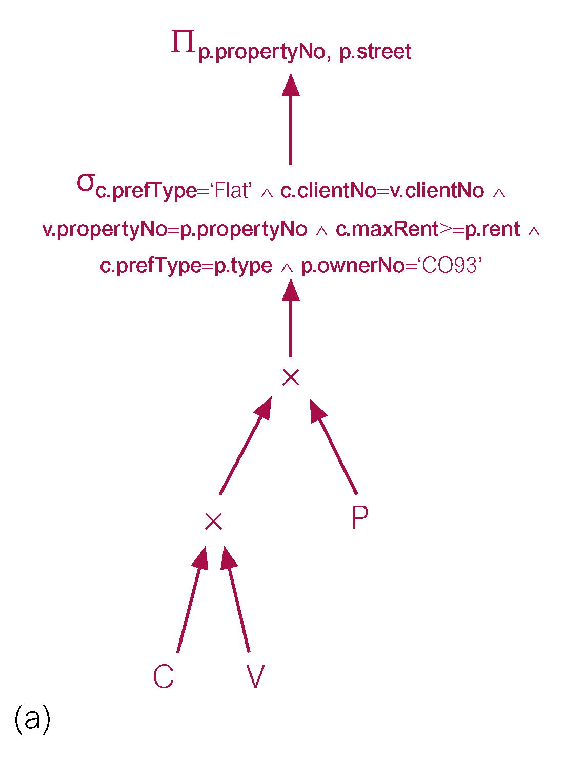
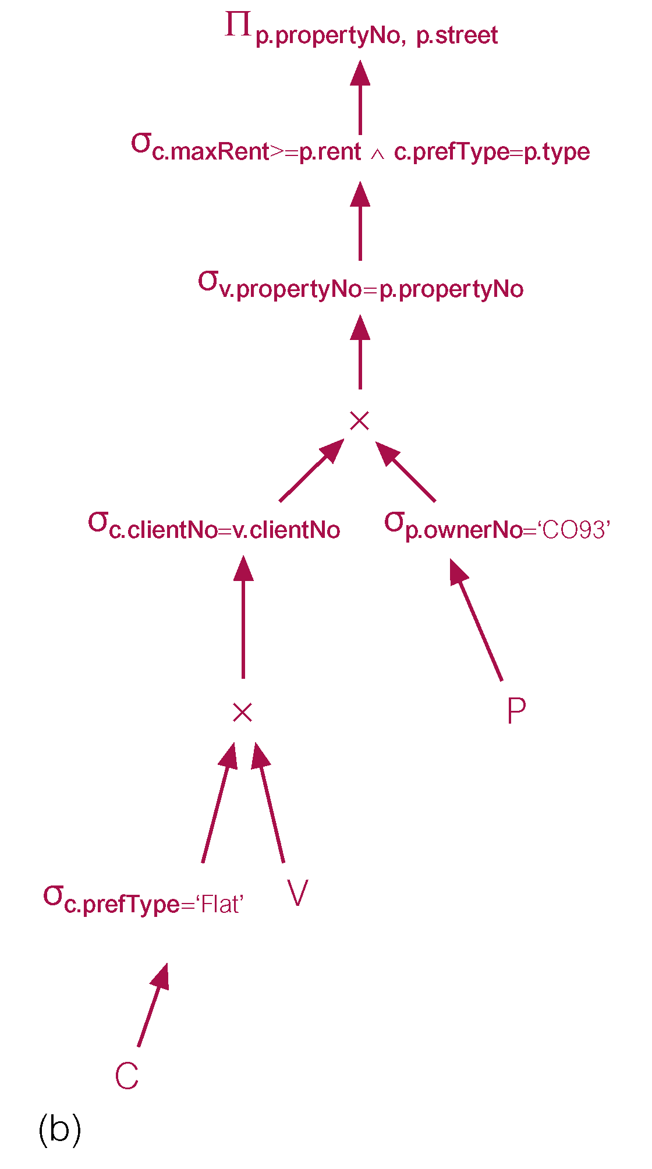
Use of Transformation Rules

Slide 38
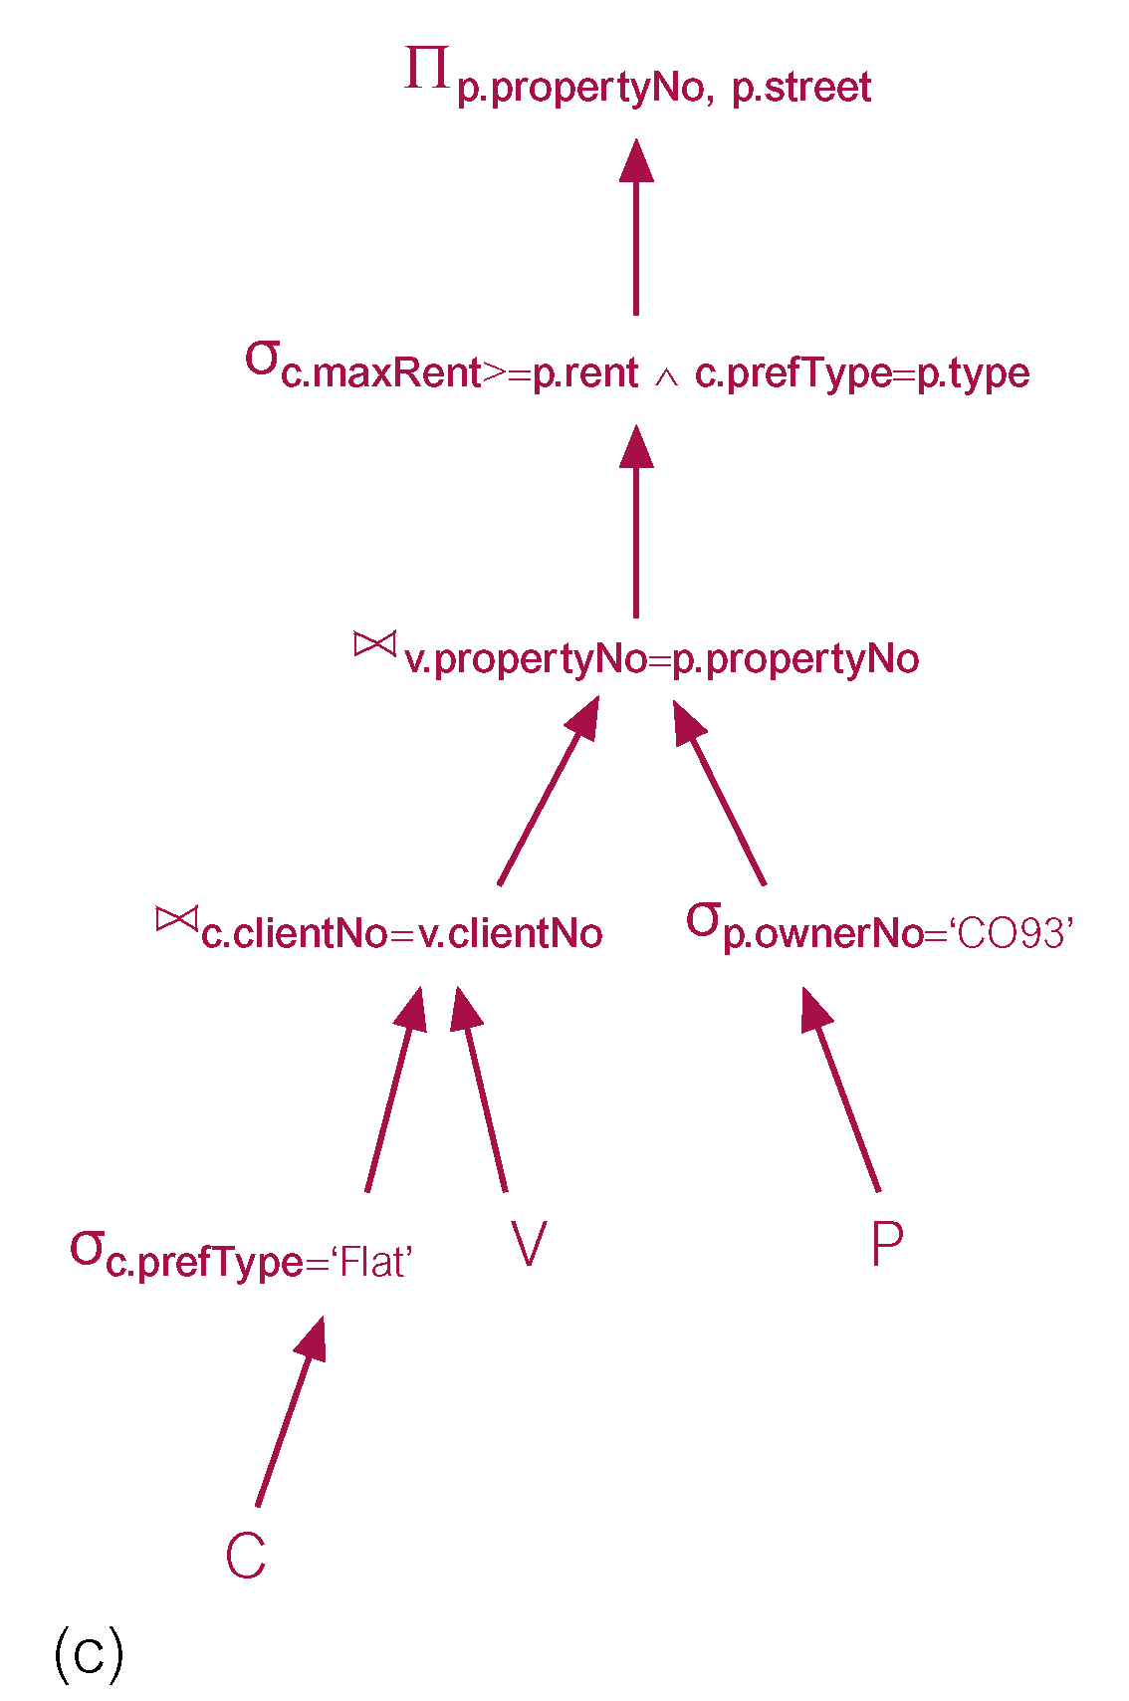
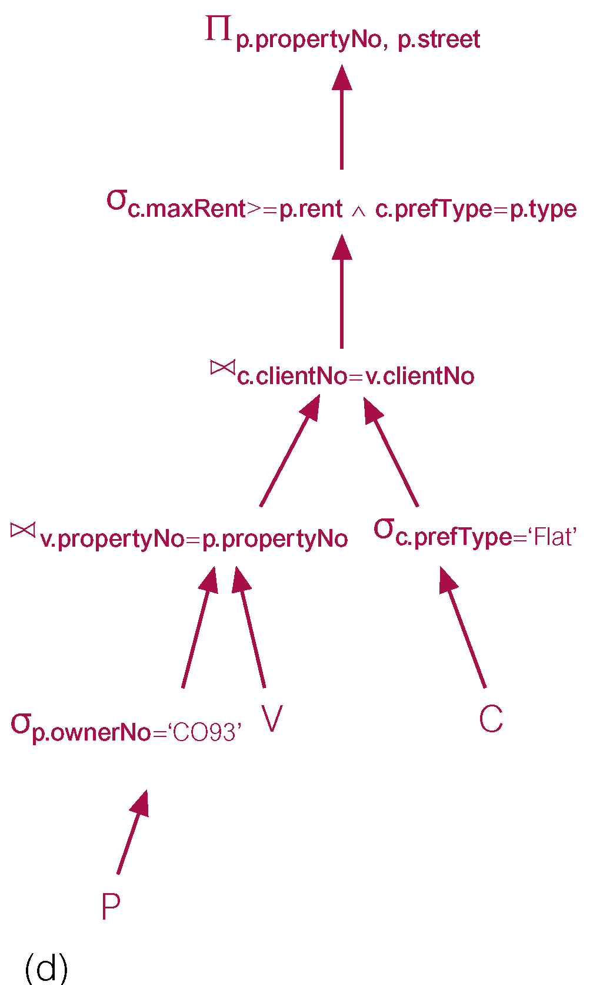
Use of Transformation Rules

Slide 39
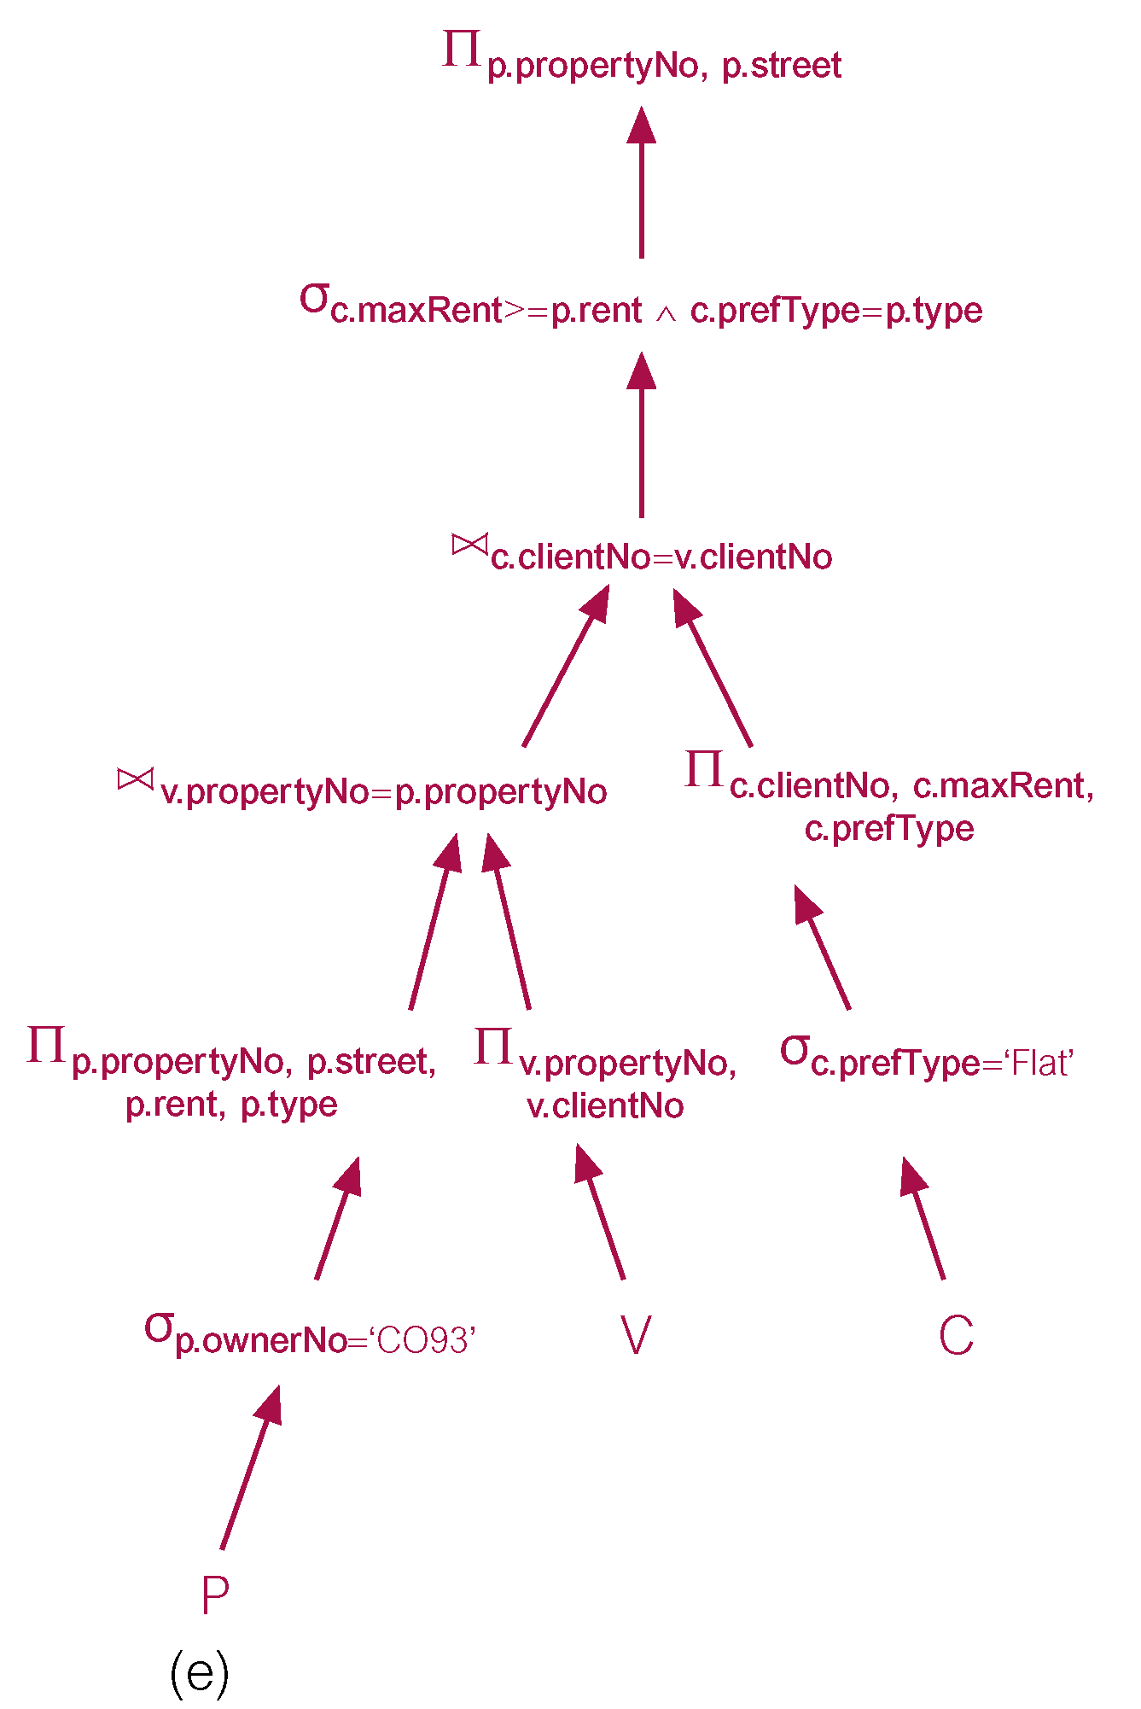
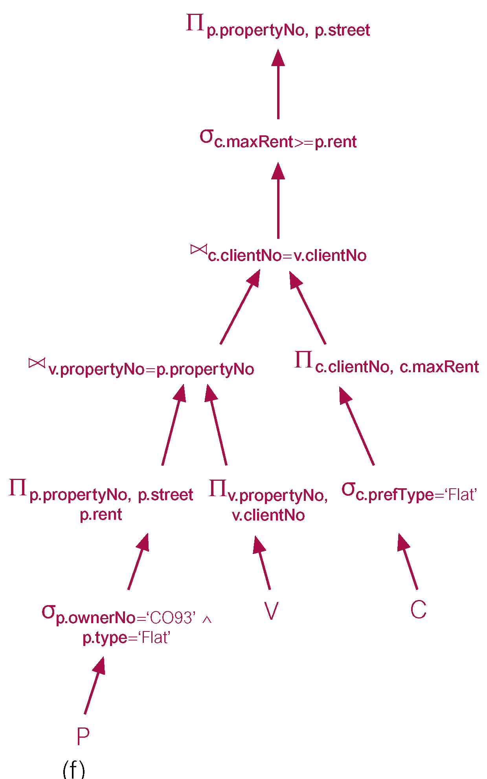
Use of Transformation Rules

Slide 40
Heuristical Processing Strategies
Perform Selection operations as early as possible.
  Keep predicates on same relation together.
Combine Cartesian product with subsequent Selection whose predicate represents join condition into a Join operation.
Use associativity of binary operations to rearrange leaf nodes so leaf nodes with most restrictive Selection operations executed first.

Slide 41
Heuristical Processing Strategies
Perform Projection as early as possible.
  Keep projection attributes on same relation together.
Compute common expressions once.
  If common expression appears more than once, and result not too large, store result and reuse it when required.

Slide 42
Cost Estimation for RA Operations
Many different ways of implementing RA operations.
Aim of QO is to choose most efficient one.
Use formulae that estimate costs for a number of options, and select one with lowest cost.
Consider only cost of disk access, which is usually dominant cost in QP.
Many estimates are based on cardinality of the relation, so need to be able to estimate this.

Slide 43
Enumeration of Alternative Strategies
Fundamental to efficiency of QO is the search space of possible execution strategies and the enumeration algorithm used to search this space.
Query with 2 joins gives 12 join orderings:
R (S T) R (T S) (S T) R (T S) R
S (R T) S (T R) (R T) S (T R) S
T (R S) T (S R) (R S) T (S R) T
With n relations, (2(n – 1))!/(n – 1)! orderings.
If n = 4 this is 120; if n = 10 this is > 176 billion.
Compounded by different selection/join methods.

Slide 44
Reducing the Search Space
Restriction 1: Unary operations processed on-the-fly: selections processed as relations are accessed for first time; projections processed as results of other operations are generated.
Restriction 2: Cartesian products are never formed unless query itself specifies one.
Restriction 3: Inner operand of each join is a base relation, never an intermediate result. This uses fact that with left-deep trees inner operand is a base relation and so already materialized.
Restriction 3 excludes many alternative strategies but significantly reduces number to be considered.

